Slide 1
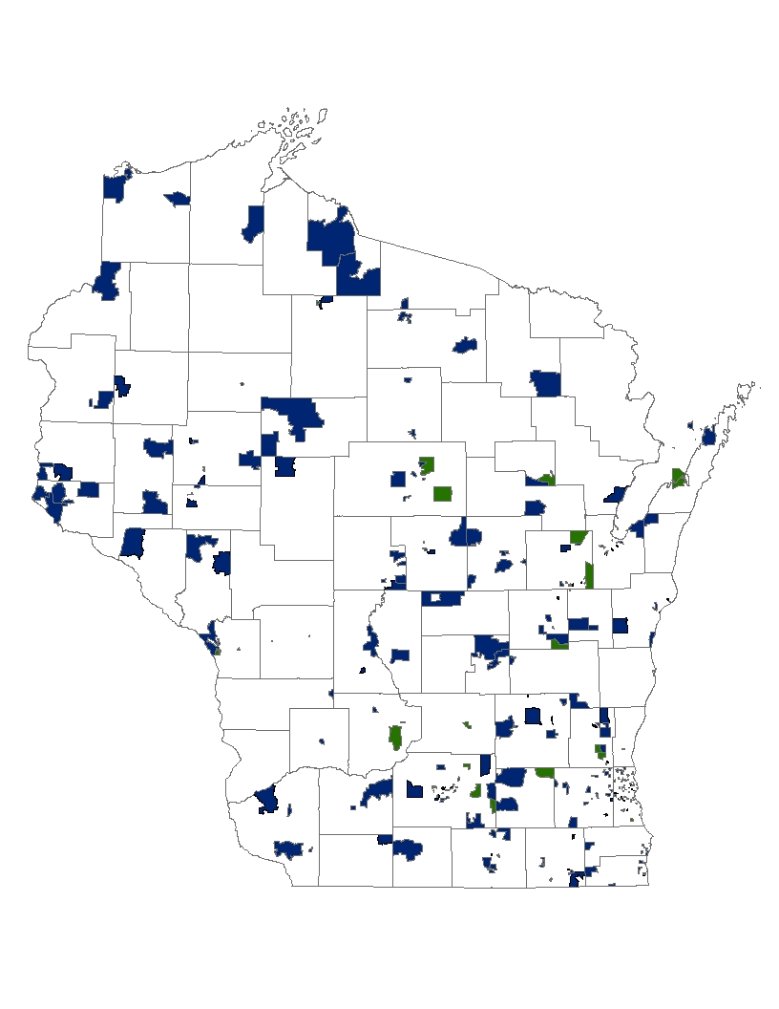
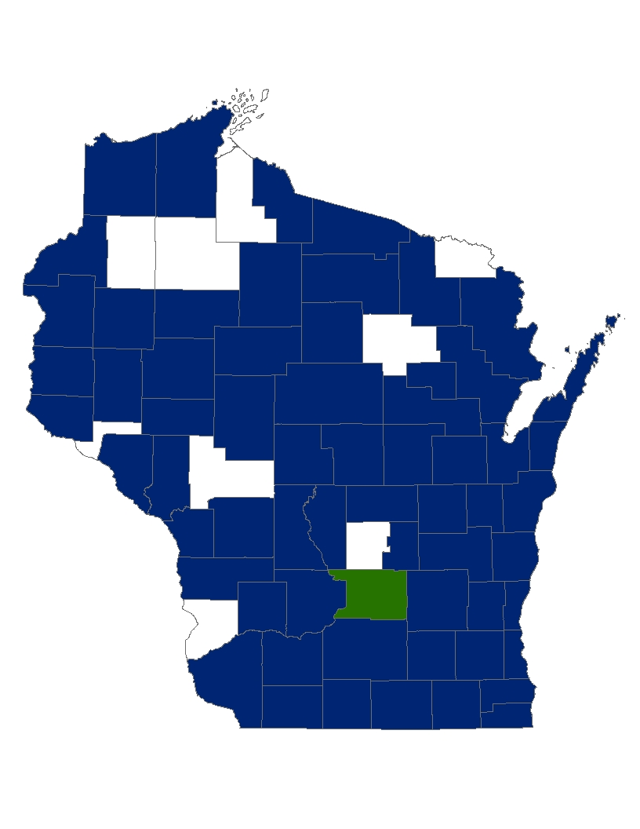

SHOW: Communities Visited
2008 - 2013
SHOW 2008 – 2012 + 2013

